Slide 1





SENTENCE AUTOCOMPLETE
Kalluri Prashanth Reddy 192111704

Slide 2

Table Of Contents:
□Introduction of Sentence Auto complete
Objective
Abstract
□Algorithm and Architecture
Screenshot
□Conclusion
□ References

Slide 3



Introduction
□The Sentence Auto complete project aims to improve typing efficiency and user experience by predicting and suggesting the next words or phrases in a sentence.
□Utilizing machine learning and natural language processing (NLP), the system understands context to provide accurate predictions.
□This technology can be used in various applications, such as email composition, coding, messaging apps, and other text input interfaces, to enhance productivity and ease of use.
□By reducing the amount of typing required, Sentence Auto complete streamlines the writing process and ensures a smoother, more efficient user experience.

Slide 4

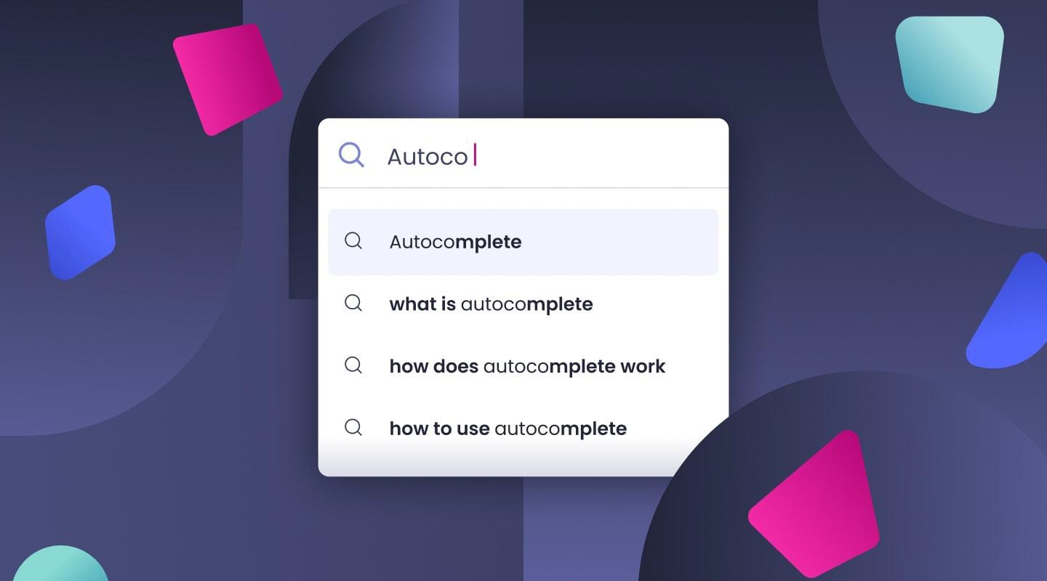
Objectives
□Predict Next Words: Develop a system that can predict and suggest the next words or phrases in a sentence.
Improve Typing Efficiency: Reduce the amount of typing required by users.
Enhance User Experience: Provide accurate and contextually relevant suggestions.
Support Multiple Languages: Extend the autocomplete functionality to multiple languages

Slide 5


Advantages In Sentence Auto complete
□Increased Typing Speed, Enhanced Productivity, Improved Accuracy, Contextual Relevance, User Convenience, Reduced Cognitive Load, Personalization, Language Support, Consistency, Accessibility

Slide 6

Abstract
□The Sentence Autocomplete project aims to create a system that enhances text input interfaces by predicting and suggesting the next words or phrases based on the context of the current input.
□By utilizing advanced machine learning models and NLP techniques, the system can significantly improve typing speed and user experience.
□This document details the algorithm, architecture, implementation, and potential applications of the Sentence Autocomplete system.

Slide 7

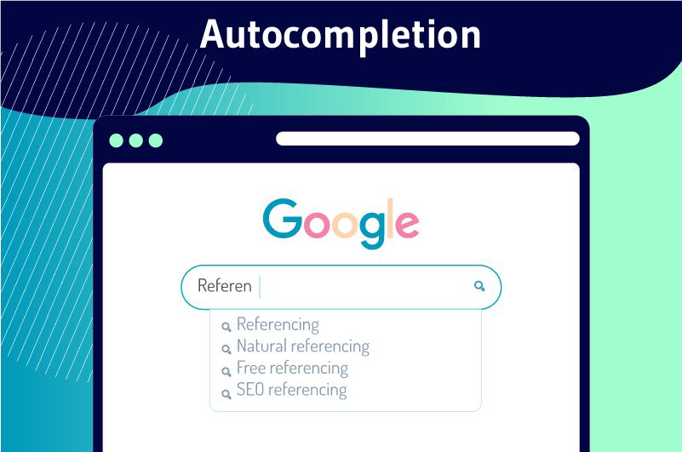
Role Of NLP
□NLP plays a crucial role in sentence autocomplete by understanding the context of the current text to predict relevant next words or phrases.
□NLP adapts to individual user writing styles for personalized suggestions, provides synonyms and alternative phrases, and supports multiple languages.
□By understanding the meaning behind words through semantic analysis, it offers contextually appropriate suggestions and completes entire phrases for more efficient typing.

Slide 8

Real time uses:
□Real-time uses of sentence autocomplete with NLP include email composition
□messaging apps
□coding assistants
□document editing
□search engines
□customer support
□social media
□accessibility tools
□language learning apps
□chatbots.

Slide 9
Flowchart:
Input Interface, Context Analysis
Database
Prediction engine
User Selection, Feedback System
Suggestion Display

Slide 10
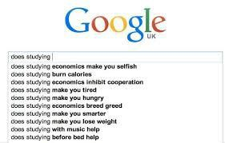
Challenges And Limitations
Context Understanding
Handling Ambiguity
Personalization
Language Variations
Real-Time Processing
Data Privacy
Bias in Predictions
User Trust
Complex Sentence
Structures
Resource Intensive

Slide 11
Execution And output:
import re
from collections import defaultdict, Counter
class SentenceAutocomplete: def init (self, corpus):
self.word_counts = Counter() self.word_followers = defaultdict(Counter) self.preprocess(corpus)
def preprocess(self, corpus):
# Tokenize the corpus into words
tokens = re.findall(r'\b\w+\b', corpus.lower())
# Count occurrences of each word and word pairs for i in range(len(tokens) - 1):
self.word_counts[tokens[i]] += 1
self.word_followers[tokens[i]][tokens[i + 1]] += 1
def suggest(self, prefix, max_suggestions=5):
# Get suggestions based on the last word in the prefix last_word = prefix.split()[-1].lower()
suggestions = self.word_followers[last_word].most_common(max_suggestions) return [word for word, _ in suggestions]
# Example corpus corpus = """
The quick brown fox jumps over the lazy dog.
The quick brown fox is very quick and very brown. Lazy dogs are not quick but they are very lazy.
"""
# Initialize the autocomplete system autocomplete = SentenceAutocomplete(corpus)
# User input
input_text = input("Start typing your sentence: ")
# Get suggestions
suggestions = autocomplete.suggest(input_text) print("Suggestions:", suggestions)
Start typing your sentence: The quick Suggestions: ['brown', 'and', 'is']

Slide 12

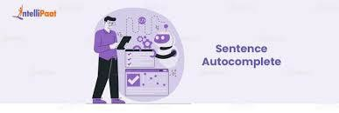

Conclusion
□This project demonstrates a sentence autocomplete system
basic using
NLP, providing word suggestions based on bigram frequencies.
□It's a simple yet effective way to enhance text input efficiency.

Slide 13


References:
□Shaikh, Aryaan, et al. "Autocomplete recommendation plugin and Summarizing Text using Natural Language Processing." Journal of Innovation Information Technology and Application (JINITA) 5.2 (2023): 114-123.
□Lee, Mina, Tatsunori B. Hashimoto, and Percy Liang. "Learning autocomplete systems as a communication game." arXiv preprint arXiv:1911.06964 (2019).
□Shaikh, A., Newalkar, N., Gaikwad, S., Kadav, N. and Shewale, C., 2023. Autocomplete recommendation plugin and Summarizing Text using Natural Language Processing. Journal of Innovation Information Technology and Application (JINITA), 5(2), pp.114-123.

Slide 14



